Slide 1
DataIO 2024
Katya Liber and Ely Maddox

Slide 2
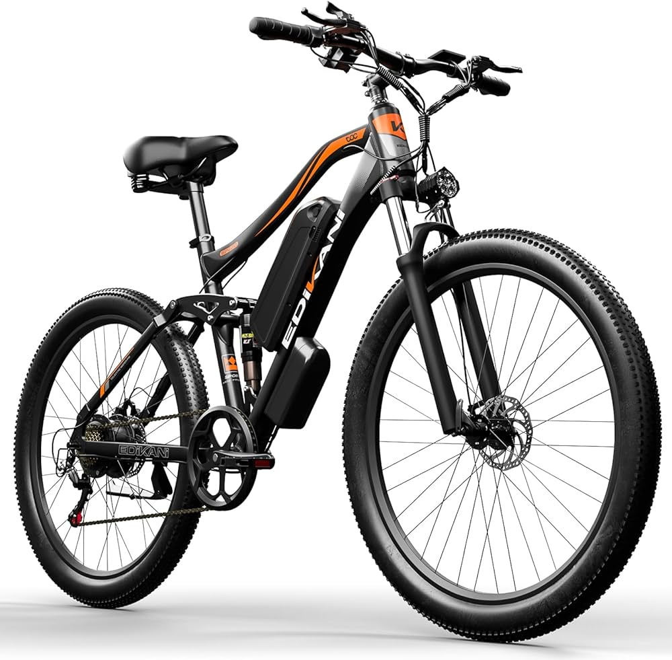
Customer Variables and Ride Time
Do characteristics of customers impact the time that they ride on Cycle bikes?
How can we predict how long a bike will be gone from a dock based on a user’s characteristics?

Slide 3
How will this help Cycle?
By bettering ride-time estimates based on a user’s profile, we can better understand when any given bike will be returned to a dock
Though we did not get to analyze how a bike beginning at any given start dock affects which dock it will end at, we did find that certain characteristics do affect a given customer’s ride time

Slide 4
Our Process
Clean the data allowed for more accurate averages to draw conclusions from
Find the ride time of each trip based on the start and end time given to us
Plot the average time against certain customer variables

Slide 5
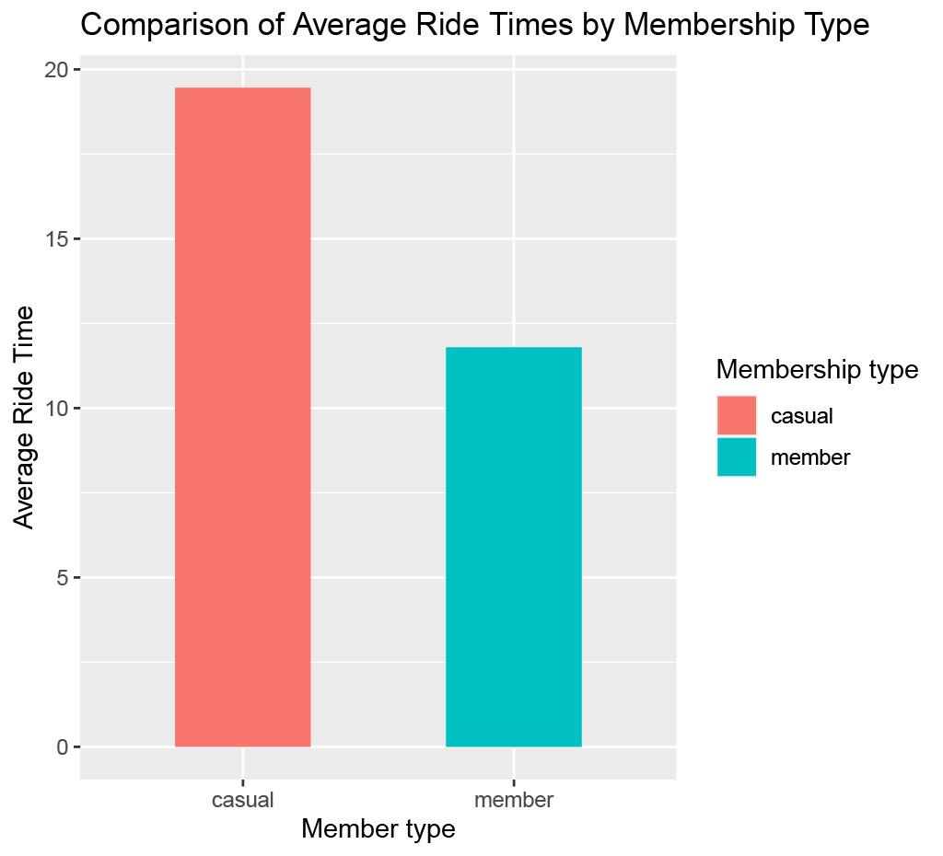
Ride Time vs. Membership Type
What we found
The average ride time of casual members is greater than the average ride time of members

Slide 6
What does this Mean?
We can expect casual users to ride longer than members
Thus, we can assume that they will take longer to return their bike to a dock for another customer to use

Slide 7
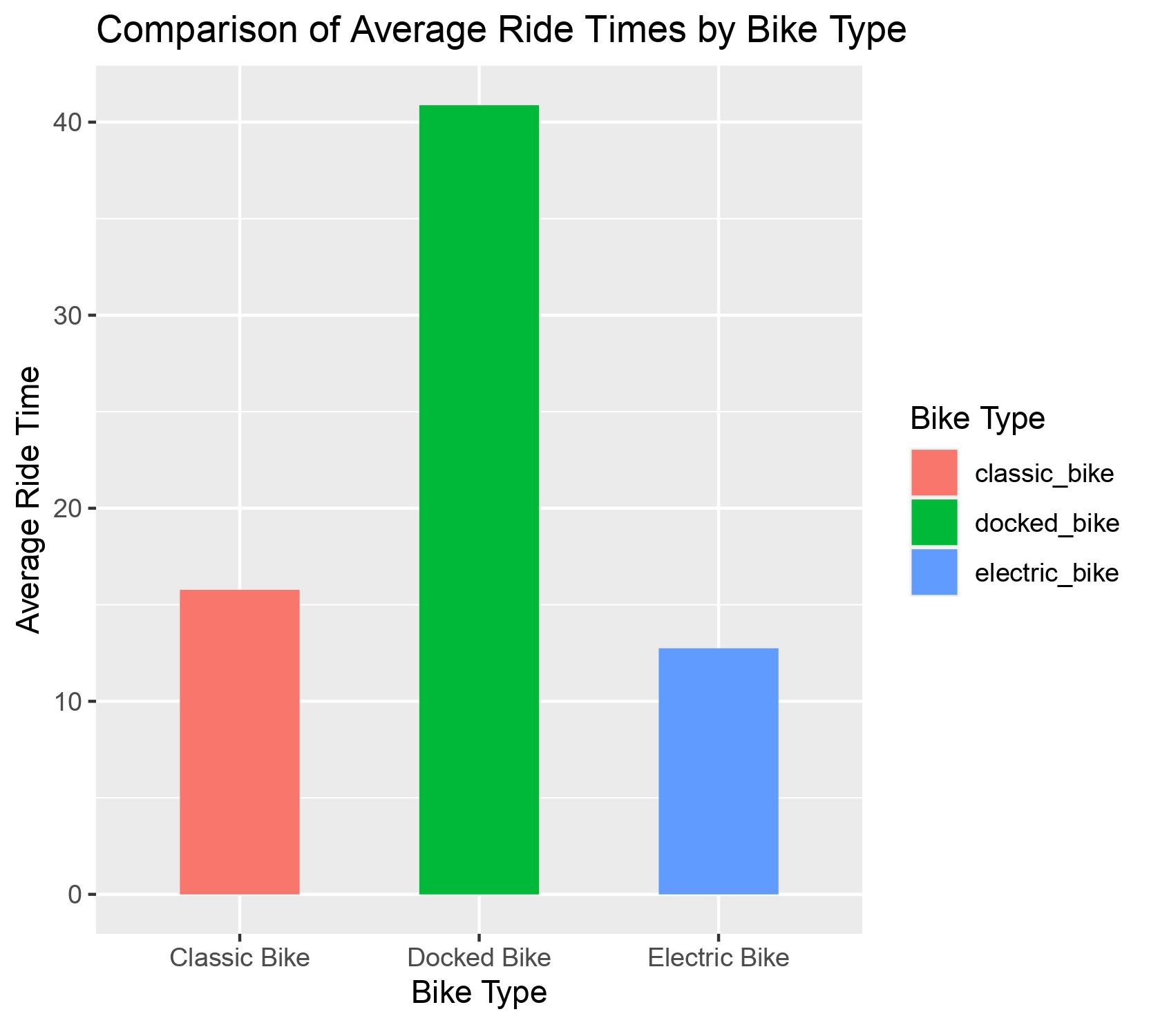
Ride Times vs Bike Type
What we found
The longest average ride time was for docked bikes, and classic bikes averaged a longer ride time than electric bikes

Slide 8
What does this mean?
We can find that classic bikes will take longer to reach their next dock than electric bicycles
Thus, if a dock is empty, customers waiting for a classic bicycle will on average have to wait longer for one than a customer at the same dock waiting for an electric bicycle

Slide 9
Conclusions
If Cycle creates an app that gives customers estimated wait times for a bicycle at a given dock, we can use these insights to better estimate that time

